Slide 1
UKS2 English Monday 13th July 2020
WALT: Use advertising language to create a poster.

Slide 2
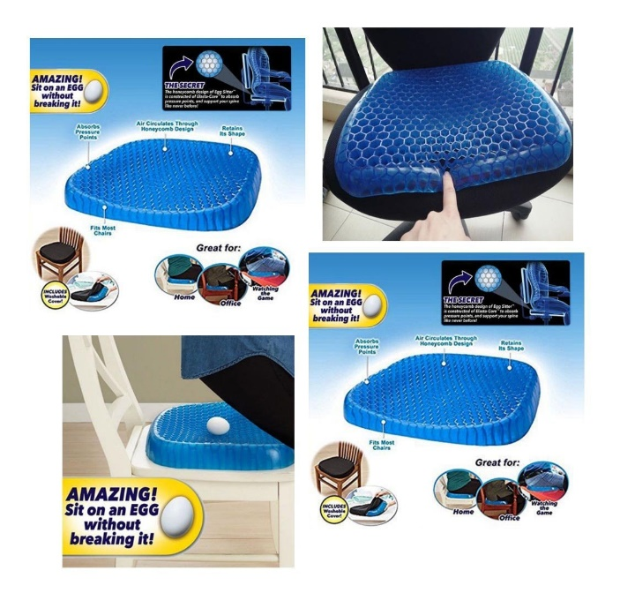
To advertise your invention, you need a poster!
Think about some of the language from the JML adverts from Friday. You can include powerful adjectives and alliteration to advertise your invention on your poster.
Your poster needs to feature:
The name of the invention and slogan if you have one
An image of the invention
It’s unique features
How it benefits year 5/6

