Slide 1
UKS2 English 21st April 2020
L.O. To use relative clauses

Slide 2
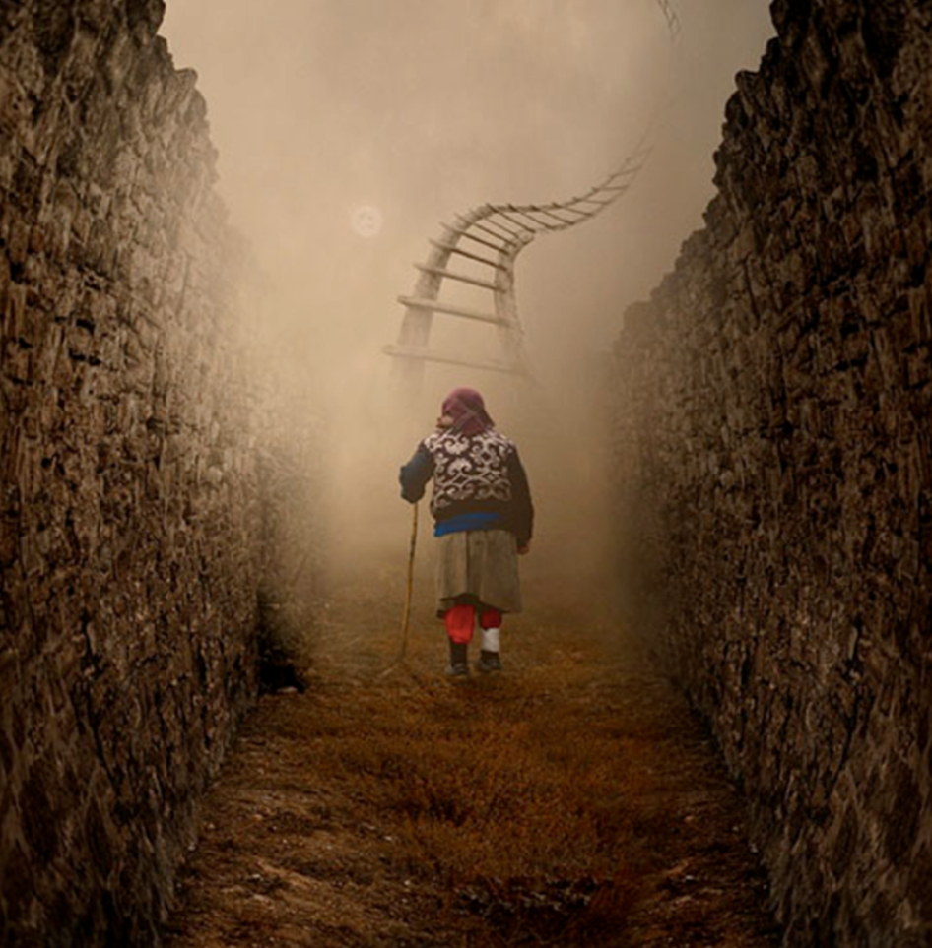
Yesterday you revised relative pronouns. Today you are going to apply that knowledge to developing your use of relative clauses.

Slide 11
Now that you have revised relative clauses, it is your turn to have a go.
Using this picture as a stimulus, write the introductory paragraph of a story about travelling up the ‘Sky Path’. Your story should be written in the first person (you are writing about your own experience).
Please try to include at least one example of a sentence which includes a relative clause.
For tips on writing a fantastic introduction watch : https://www.youtube.com/watch?v=M2H29fRVqf8
We would love to see some of your examples. You can email them to us.
Happy climbing!

