Slide 1
UKS2 English
19th May 2020
WALT: Develop punctuation use to include semi-colons.

Slide 3
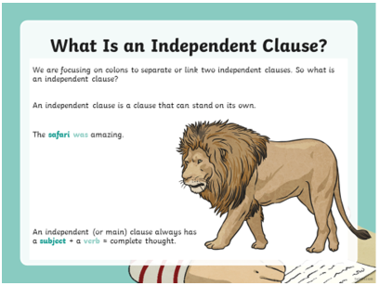

Slide 4
Look at how the semi-colons have been used to separate two closely related independent clauses instead of using a conjunction (FANBOY).

Slide 7
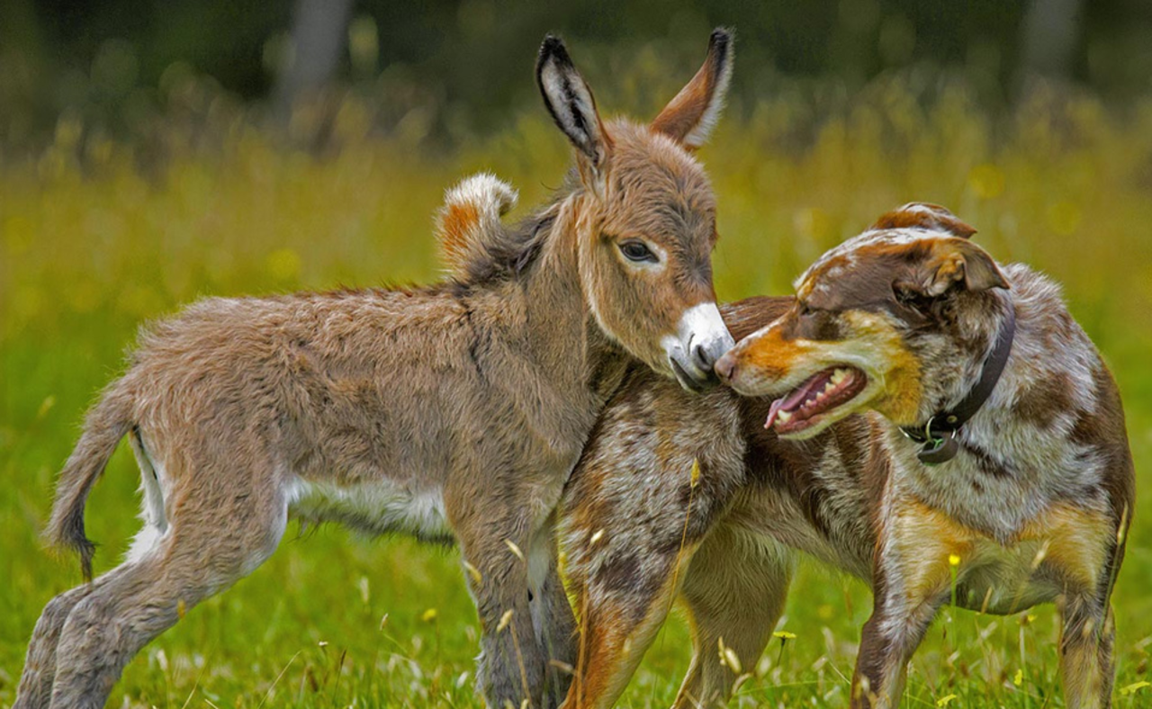
Our picture stimulus for this week is called ‘Unlikely Friends’.

Slide 8
Using our picture stimulus, write three of your own sentences to show that you know how to use semi-colons to replace conjunctions when joining two closely related independent clauses. Look at the next slide for vocabulary to include!

Slide 9
In order to increase your vocabulary choices, please try to use the following words in your sentences: - muted - restrained - subdued

