Slide 1
UKS2 English 14th May 2020
L.O. To write a recount.

Slide 2
What is a recount?
A recount text is a piece of writing that gives details of an event that has happened.
Watch this BBC Bitesize video by Michael Rosen to find out more.
https://www.bbc.co.uk/bitesize/articles/zk3tpg8

Slide 3
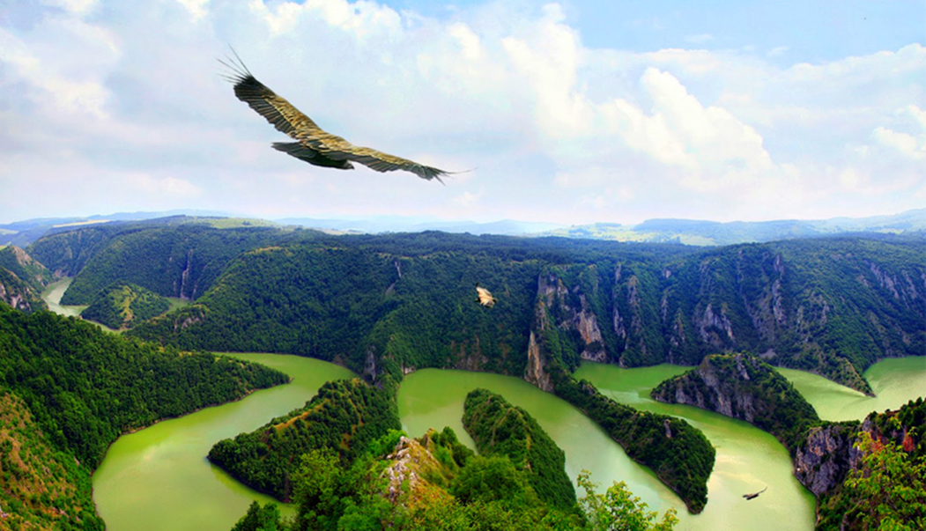
When writing a recount, we need to make sure that we answer all of the following questions:
Who did the activity?
What did they do?
When did it happen?
Where did it all take place?
Why was the activity carried out?

Slide 4
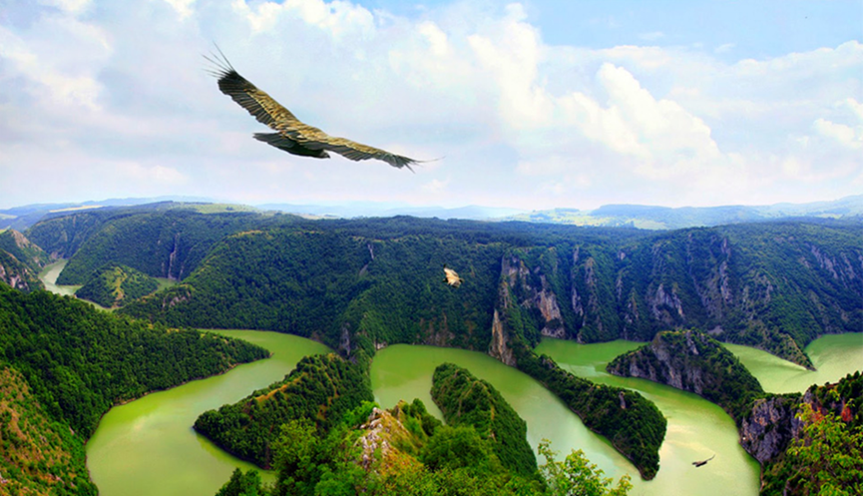
Your task is to write a short recount in the first person as if you were the bird. You are going to write about your short flight, circling over the rainforest below.
You will need to answer the questions from the previous slide.
You will also need to make sure that you include colons to :
introduce a list and separate two independent clauses when the second clause explains or gives more detail about the first clause.
You should have sentences from your previous two lessons that you can use for this if you wish to.

Slide 5
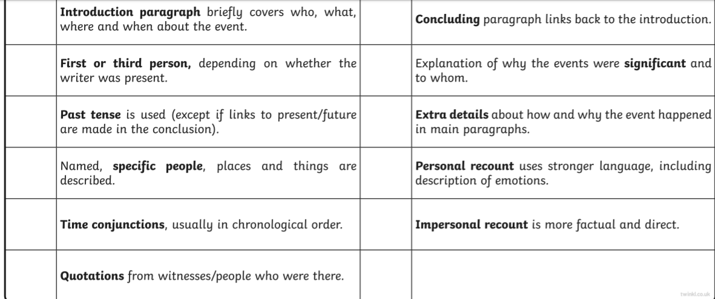
Your First Person Recount Should Include:

Slide 6
Some Possible Time Conjunctions

