Slide 1
UKS2 English Wednesday 24th June 2020
L.O. To turn an old poem into a modern story.

Slide 2
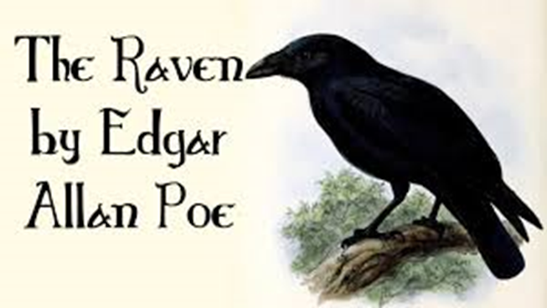
As you know, The Raven was written in 1845. You have already identified some unfamiliar and old fashioned language.

Slide 3
Your task is to write a short sentence to summarise the events in each stanza. There should be 18 sentences in total.
1. I was napping when I heard knocking at my door.

