Slide 1
Year 5 Spellings 15th May 2020
Challenge Words

Slide 2
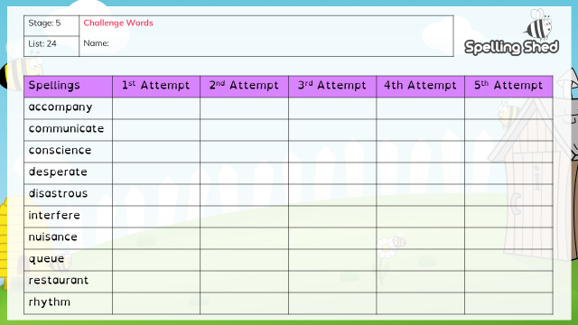

Slide 3
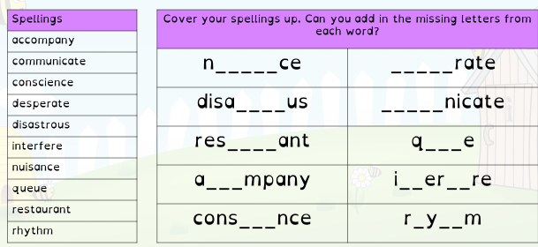

Slide 4
Additional Challenge!
I am setting you an additional challenge and I think you are going to like it!
Your challenge is to see how many of the spelling words you can put into a sentence. Warning! Your sentence must make sense and the words must be spelled correctly!
Please send us any sentences that you are particularly proud of.

